Slide 1
Lambdas & LINQ in C#

Slide 2
AGENDA
Lambdas
What is LINQ
Work with LINQ
IEnumerable<T> and LINQ
Expression Trees
IQueryable<T>

Slide 3


COMMON USES
LINQ (Language Integrated Query)
Func<T> and Action<T>
Callbacks and Event Handlers

Slide 4
ANATOMY
  Common to use single letter parameter names
  s.StudentName == “John”
  (Student s)
  =>
3 Parts
  Parameter(s)
  => “goes to” operator
  Expression or Statements
Expression Lambda
Statement Lambda
  (object s, EventArgs e) =>
  {
    ListBox.ItemSource = e.Result;
    Console.WriteLine(“Hello”);
  }

Slide 5
SYNTACTIC VARIATIONS
Optional Parameter Types (Parameter Type Inference)
  (s, e) => { Console.WriteLine(e.Result); }
Optional Parentheses for a Single Statement
  e => { Console.WriteLine(e.Result);
Optional Braces for a Single Statement
  e => Console.WriteLine(e.Result);
Empty Parentheses for No Parameter
  () => { Console.WriteLine(“John”); }

Slide 6
Quiz #1
Create lambda expression with two string parameters and return result which contains the parameters in Upper case.

Slide 7
Quiz #2
Create lambda expression with one int parameter and if the parameter is even then write it in console, return double value of parameter , else return 0

Slide 8
LINQ
Linq sturcture.
Notation of LINQ.
Standart operators.

Slide 9
When we need LINQ?
What option is better and why?
Without LINQ
  Classic notation (js)
https://e3s.epam.com/eco/rest/e3s-eco-scripting-impl/0.1.0/data/searchFts?
metaType=meta:people-suite:people-api:com.epam.e3s.app.people.api.data.EmployeeEntity
&query={"statements":[{"query":"workstation:(EPRUIZHW0060)"}],"filters":null,"sorting":null,"start":0,"limit":1}
With LINQ
  Short expresion
  Uniform query language
  Readable
employees.Where(e => e.workstation == "EPRUIZHW0060")
Notes:
Пример

Slide 10
Demo

Slide 11
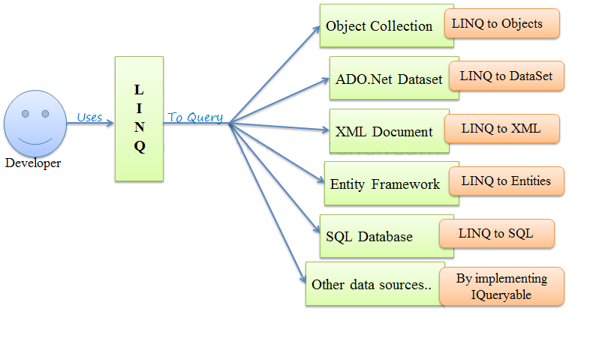
WHAT IS LINQ?

Slide 12
LINQ API
Enumerable class (includes extension methods for the classes that implement IEnumerable<T> interface)
Queryable class (includes extension methods for classes that implement IQueryable<T> interface)

Slide 13
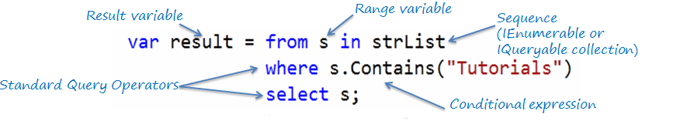
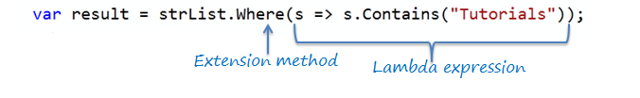
LINQ SYNTAX
LINQ Query Syntax
LINQ Method Syntax

Slide 14
STANDARD QUERY OPERATORS
Classification | Standard Query Operators
Filtering | Where, OfType
Sorting | OrderBy, OrderByDescending, ThenBy, ThenByDescending, Reverse
Grouping | GroupBy, ToLookup
Join | GroupJoin, Join
Projection | Select, SelectMany
Aggregation | Aggregate, Average, Count, LongCount, Max, Min, Sum
Quantifiers | All, Any, Contains

Slide 15
Elements | ElementAt, ElementAtOrDefault, First, FirstOrDefault, Last, LastOrDefault, Single, SingleOrDefault
Set | Distinct, Except, Intersect, Union
Partitioning | Skip, SkipWhile, Take, TakeWhile
Concatenation | Concat
Equality | SequenceEqual
Generation | DefaultEmpty, Empty, Range, Repeat
Conversion | AsEnumerable, AsQueryable, Cast, ToArray, ToDictionary, ToList

Slide 16
FILTERING
FILTERING
Where() method overloads: public static IEnumerable<TSource> Where<TSource>(this IEnumerable<TSource> source,
Func<TSource, bool> predicate); public static IEnumerable<TSource> Where<TSource>(this IEnumerable<TSource> source,
Func<TSource, int, bool> predicate);
Filtering Operators | Description
Where | Returns values from the collection based on a predicate function
OfType | Returns values from the collection based on a specified type. However, it will depend on their ability to cast to a specified type.

Slide 17
SORTING OPERATORS
Sorting Operator | Description
OrderBy | Sorts the elements in the collection based on specified fields in ascending or decending order.
OrderByDescending | Sorts the collection based on specified fields in descending order. Only valid in method syntax.
ThenBy | Only valid in method syntax. Used for second level sorting in ascending order.
ThenByDescending | Only valid in method syntax. Used for second level sorting in descending order.
Reverse | Only valid in method syntax. Sorts the collection in reverse order.

Slide 18
Projection Operators: Select, SelectMany
Select:
  The Select operator always returns an IEnumerable collection which contains elements based on a transformation function. It is similar to the Select clause of SQL that produces a flat result set.
Select Many:
  The SelectMany operator projects sequences of values that are based on a transform function and then flattens them into one sequence

Slide 19
Demo

Slide 20
Quantifier Operators
The quantifier operators evaluate elements of the sequence on some condition and return a boolean value to indicate that some or all elements satisfy the condition.
Operator | Description
All | Checks if all the elements in a sequence satisfies the specified condition
Any | Checks if any of the elements in a sequence satisfies the specified condition
Contain | Checks if the sequence contains a specific element

Slide 21
Aggregation Operators
The aggregation operators perform mathematical operations like Average, Aggregate, Count, Max, Min and Sum, on the numeric property of the elements in the collection.
Method | Description
Aggregate | Performs a custom aggregation operation on the values in the collection.
Average | Calculates the average of the numeric items in the collection.
Count | Counts the elements in a collection.
LongCount | Counts the elements in a collection.
Max | Finds the largest value in the collection.
Min | Finds the smallest value in the collection.
Sum | Calculates sum of the values in the collection.

Slide 22
Demo

Slide 23
Element Operators
Element operators return a particular element from a sequence (collection).
Element Operators | Description
ElementAt | Returns the element at a specified index in a collection
ElementAtOrDefault | Returns the element at a specified index in a collection or a default value if the index is out of range.
First | Returns the first element of a collection, or the first element that satisfies a condition
FirstOrDefault | Returns the first element of a collection, or the first element that satisfies a condition. Returns a default value if index is out of range.
Last | Returns the last element of a collection, or the last element that satisfies a condition
LastOrDefault | Returns the last element of a collection, or the last element that satisfies a condition. Returns a default value if no such element exists.
Single | Returns the only element of a collection, or the only element that satisfies a condition.
SingleOrDefault | Returns the only element of a collection, or the only element that satisfies a condition. Returns a default value if no such element exists or the collection does not contain exactly one element.

Slide 24
Conversion Operators
The Conversion operators in LINQ are useful in converting the type of the elements in a sequence (collection). There are three types of conversion operators: As operators (AsEnumerable and AsQueryable), To operators (ToArray, ToDictionary, ToList and ToLookup), and Casting operators (Cast and OfType).
Method | Description
AsEnumerable | Returns the input sequence as IEnumerable<t>
AsQueryable | Converts IEnumerable to IQueryable, to simulate a remote query provider
Cast | Coverts a non-generic collection to a generic collection (IEnumerable to IEnumerable<T>)
OfType | Filters a collection based on a specified type
ToArray | Converts a collection to an array
ToDictionary | Puts elements into a Dictionary based on key selector function
ToList | Converts collection to List
ToLookup | Groups elements into an Lookup<TKey,TElement>

Slide 25
Other operators.
Joining Operator
Equality Operator
Other...

Slide 26
Demo

Slide 27
Quiz #1
What interfaces are used in linq api?
Please provide examples of classes which Implement the interfaces.

Slide 28
Quiz #2
You have a massive of int.
  You want to find the first element equal to 5:
  You want to find the last element equal to 14
  You want to find only single or default element equal to 4
  You want to find the first element equal to 6 or get default.
What methods of Linq should be used here?

Slide 29
Quiz #3
You have a massive of students.
  You want to find students who older than 25.
  You want to sort massive by FirstName (the field of class “student”).
  You sort students by FirstName after that you want to sort students by Date of birthday (the field of class “student” )
What methods of Linq should be used here?

Slide 30
IEnumerable and IQueryable
What is IEnumerable
IEnumerable: proc and cons
What is IQueryable
What is Expression Tree

Slide 31
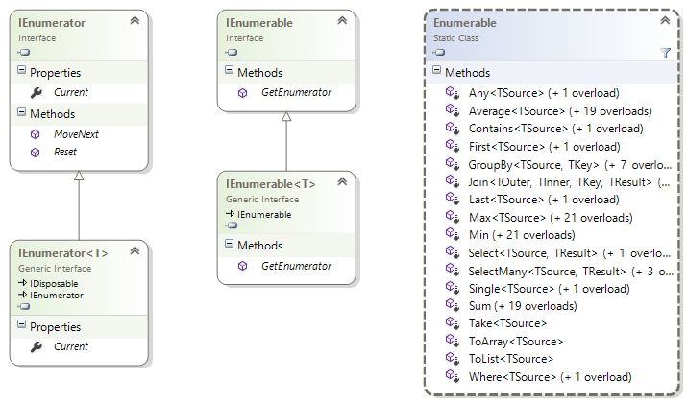
IEnumerable

Slide 32
How it works…
public static IEnumerable<T> MyWhere<T>(
this IEnumerable<T> source, Func<T, bool> predicate)
{
if (source == null) throw new ArgumentNullException("source");
if (predicate == null) throw new ArgumentNullException("predicate");
foreach (var e in source)
{
if (predicate(e))
yield return e;
}
}
int[] source = Enumerable.Range(1, 20).ToArray();
foreach (var i in source.MyWhere(x => x % 2 == 0).Select(x => x + 1))
{
Console.Write("{0} ", i);
}

Slide 33
Demo

Slide 34
IEnumerable: proc and cons
Pros
Cons
Simple
Full LINQ support
Work only with in-memory object
LINQ can’t be translated into other Language

Slide 35
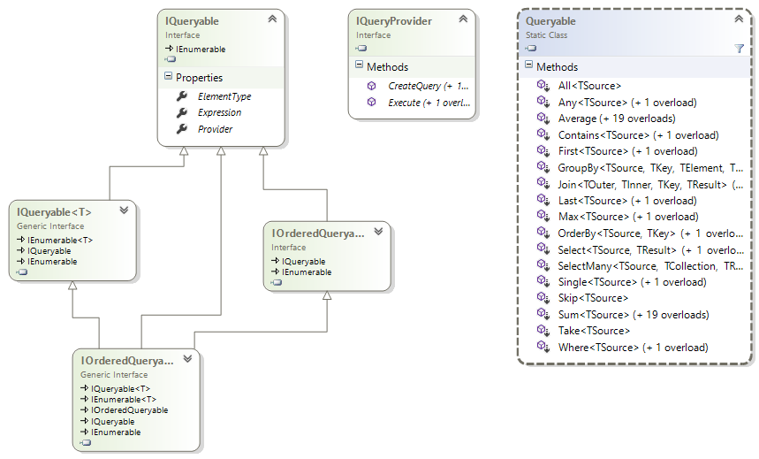
IQueryable vs. IEnumerable

Slide 36
IQueryable vs. IEnumerable
public static class Enumerable
{
public static IEnumerable<TSource> Where<TSource>(
this IEnumerable<TSource> source, Func<TSource, bool> predicate)
}
public static class Queryable
{
public static IQueryable<TSource> Where<TSource>(
this IQueryable<TSource> source, Expression<Func<TSource, bool>> predicate)
}

Slide 37
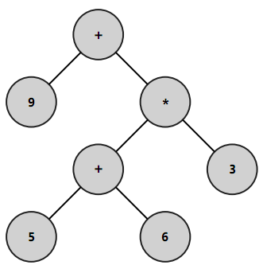
What is Expression Tree?
9 + (5 + 6) * 3

Slide 38
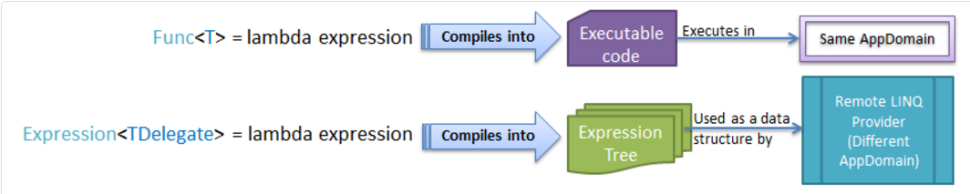
Expression vs. Lambda
Func<int, int> lambda = (a) => 1 + a;
Expression<Func<int, int>> expression = (a) => 1 + a;
Console.WriteLine(lambda);
Console.WriteLine(expression);
System.Func`2[System.Int32,System.Int32]
a => (1 + a)

Slide 39
Demo

Slide 40
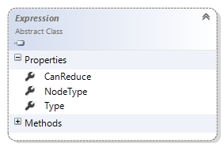
Expression Object
Type – type of expression result
Node – type of node in Expression Tree:
  Constant/Unary Expression/Binary Expression/Method Call/ …

Slide 41
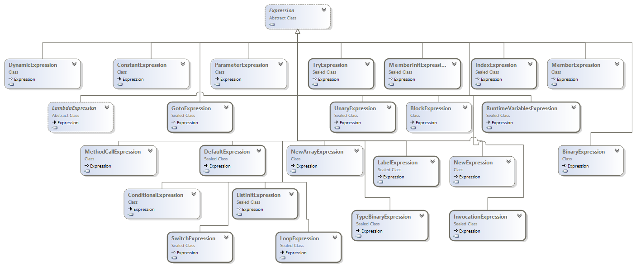
Expression Hierarhy

Slide 42
Creating Expression
Compiler (from lambda)
Programmer (“manualy”)
var exp1 = Expression.Lambda(
Expression.Add(
Expression.Constant(1),
Expression.Multiply(
Expression.Constant(3),
Expression.Constant(5)
)
));
Expression<Func<int>> exp1 = () => 1 + 3 * 5;
Expression is immutable!

Slide 43
Evaluating Expression
Expression<Func<int, int>> exp1 = (a) => 1 + a;
Console.WriteLine("{0} : {1}", exp1, exp1.Compile().Invoke(3));
Expression<Action<int>> exp2 = (a) => Console.WriteLine(a);
Console.WriteLine("{0} : ", exp2);
exp2.Compile().Invoke(3);
a => (1 + a) : 4
a => WriteLine(a) :
3

Slide 44
The Tutorials PLINQ and LINQ To XML
PLINQ
LinQ To XML Tutorial

Slide 45
LINQ To XML Tutorial Basics
Retrieving Data Using linq To XML
Inserting Data Using Linq To XML
Modify Existing Data Using Linq To XML
Delete A Record From XML File Using Linq

Slide 46
Demo

Slide 47
PLINQ
What is PLINQ.
When is PLINQ used.

Slide 48
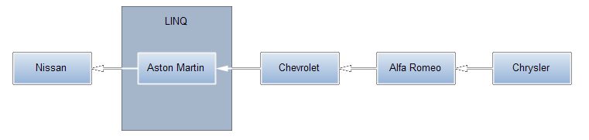
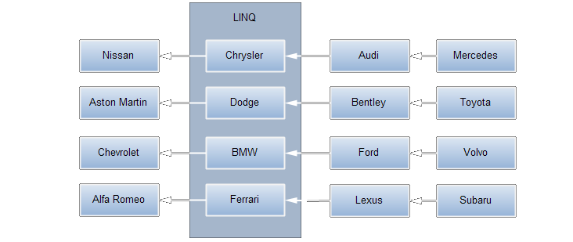
PLINQ vs. LINQ
How does LINQ work
How does PLINQ work

Slide 49
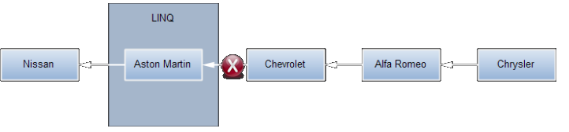
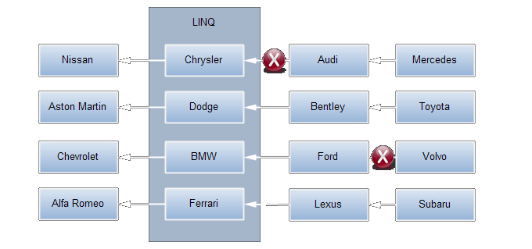
PLINQ vs LINQ. Errors.
LINQ
PLINQ

Slide 50
Demo

Slide 51
Additional materials
Programming Microsoft LINQ in .NET Framework 4 (book)
LINQ: Building an IQueryable provider series (blog)
Expression Trees (MSDN)
Dynamic Language Runtime (MSDN)

Slide 52
Libraries and Tools
Serialize.Linq (GitHub, NuGet)
Expression Tree Visualizer (for Debug in VS 2013). Version for VS 2015

